Slide 1

Georgetown Capstone
Cohort 14
Booksville Team
Suchit Sharma
Elsa Abebe (Team Spokesperson)
Kamal Rangavajhula
Wesenyelew Sima

Slide 2





ROADMAP
Motivation and Hypothesis
Data Source
Data Ingest and Wrangling
Exploratory Data Analysis
Feature Selection
Model Evaluation
Result
Conclusion

Slide 3


Slide 4


Slide 5

Hypothesis
Predict future sale price of a book based on historic Amazon sale data

Slide 6

Data Source
Data Collection Agency
Maintains price history of all products on Amazon
Based in Germany
Provides data via tokenized API

Slide 7
Architecture
Keepa
Product Sale History
PostgreSQL
Data Ingest
Psycopg2 / SQL
Data Wrangling
Pandas
Feature Selection
Scipy / Numpy / Scikit-learn
Model Evaluation
Scikit-learn / Math
Hyperparamerter Tuning
Scikit-learn
Reporting and Visulaization
Yellowbrick / Seaborn

Slide 8
Data Ingest
Challenge
Keepa API token bottleneck allowed only 1 or records per minute
API key set to expire within few weeks of obtaining it
Solution
We requested a data dump file from Keepa

Slide 9

Other Data Sources
Goodreads database
To match null Author values

Slide 10
Data Wrangling
Initial Data set:
100,192 records and 79 columns
No Price – Calculated using three columns
Removed columns with 50%+ null values
Replace categorical nulls with Unknown
Converted to appropriate data types
Dropped columns no relevant information
Dropped columns with identical information as other columns.
Pre-EDA Data Set:
99,600 records and 49 columns

Slide 11
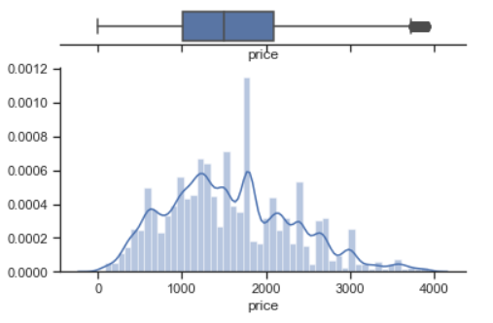
Exploratory Data Analysis
In
96,000 records; 49 features
Categorical Group Reduction
Identified categorical columns with long tail of unique but similar values
Replaced similar values (‘Middle English’) with superset values (‘English’)
Column values with < 10 frequency were grouped into ‘Others’
15 Categorical Columns encoded using LableEncoder
Outliers identified using Tukey’s fences and dropped
Low variance features identified using VarianceThreshold method and dropped
Out
94,981 records; 37 features

Slide 12
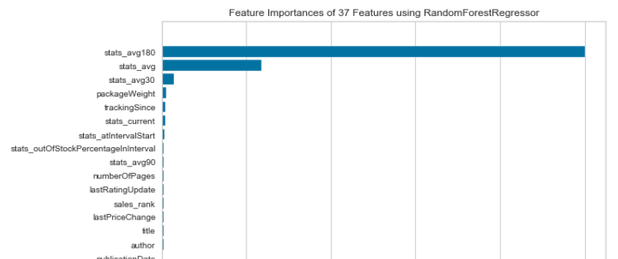
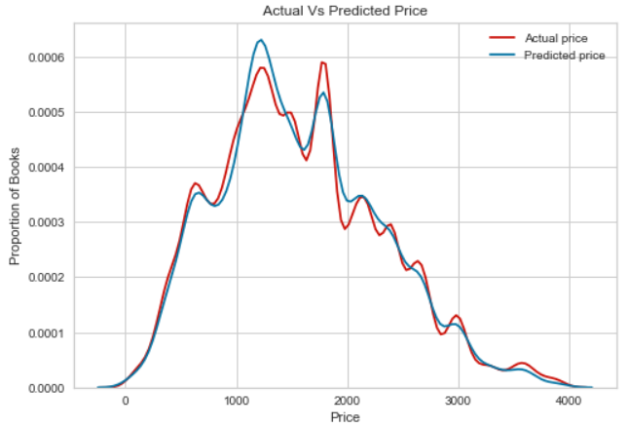
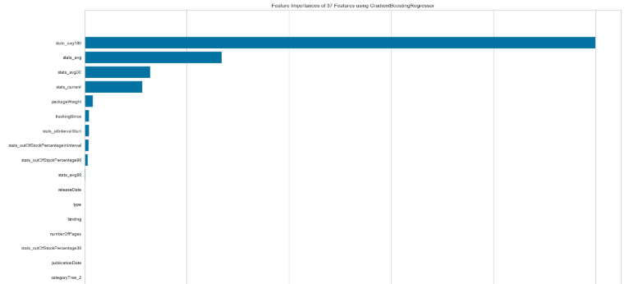
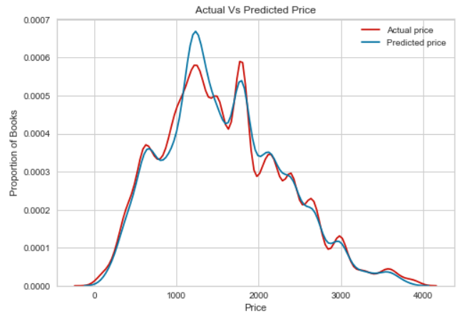
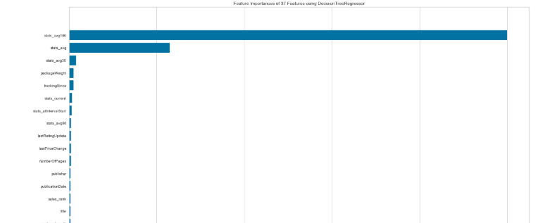
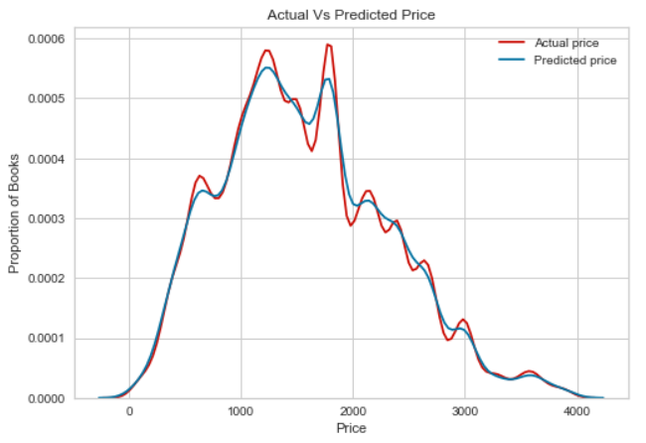
Feature Selection
Random Forest
Gradient Boosting
No
Features
Dropped
Decision Tree

Slide 13
Model Evaluation
Scikit-learn Model Selection
Accuracy & MSE
Yellowbrick Residuals
Cross
Validation
Yellowbrick Validation Curve

Slide 14
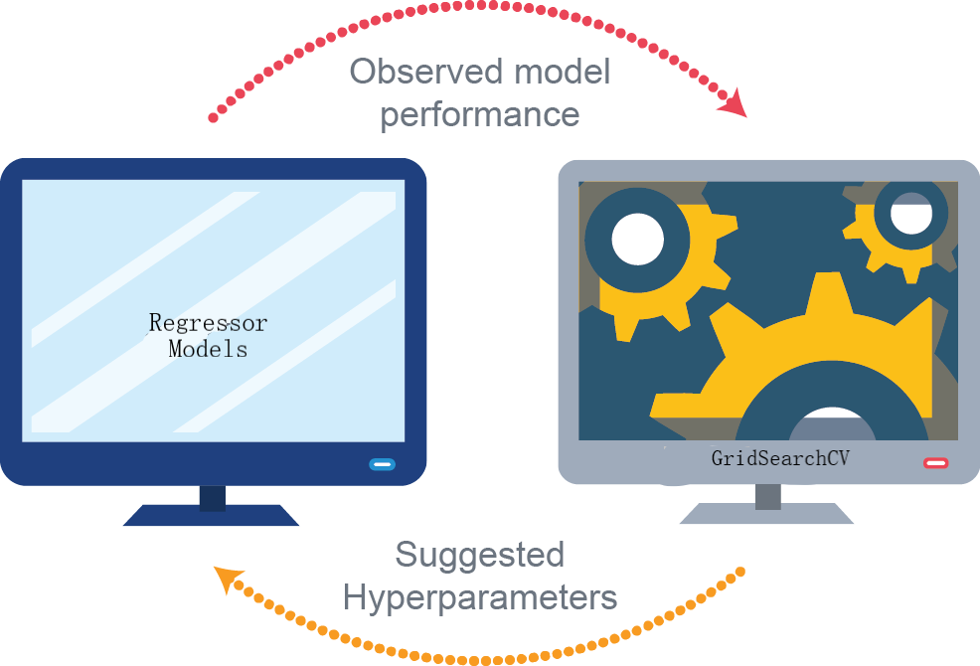
Hyperparameter Tuning Scikit-learn GridSearchCV
Model | Accuracy | HPY Accuracy
Decision Tree Regressor | 0.879 | 0.928
Gradient Boosting Regressor | 0.937 | 0.939
Random Forest Regressor | 0.936 | 0.940

Slide 15
Result

Slide 16
Conclusion

Slide 17

Questions

Slide 18


